Slide 1

Erasure-Coded Key-Value Stores with Side Information
Ramy E. Ali
Algorithms, Analytics & Augmented Intelligence group, Math of Communications department, August 2018

Slide 2
Outline
Key-value Stores Overview
Background: Replication & Erasure Coding
Coding with Side Information: Problem Formulation
Impossibility Results
Code Constructions
Case Study: Latency-Storage Trade-off in AWS
Discussion

Slide 3
Key-value Stores
Applications: reservation systems, financial transactions, distributed computing, …
Numerous key-value stores: Amazon Dynamo, Apache Cassandra, and CouchDB

Slide 4

Distributed Key-value Stores
Data is stored over multiple nodes.
failure

Slide 5

Distributed Key-value Stores
Data is stored over multiple nodes.
Data is asynchronously updated.
Write client
$${value: W}_{1}$$

Slide 6

Distributed Key-value Stores
Data is stored over multiple nodes.
Data is asynchronously updated.
Write client
Write client
$${value: W}_{1}$$
$${value: W}_{2}$$

Slide 7

Distributed Key-value Stores
Data is stored over multiple nodes.
Data is asynchronously updated.
Client must get the latest possible version of the data [Lamport 1979, ABD 1995].
Write client
Write client
$${value: W}_{1}$$
$${value: W}_{2}$$
Read client: reads $W_{2}$

Slide 8




Distributed Key-value Stores
Asynchrony Data updates may not arrive at all servers simultaneously.
$$−$$
$$−$$
$$−$$
$$W_{1}$$
$$−$$
$$−$$

Slide 9

Distributed Key-value Stores
Asynchrony Data updates may not arrive at all servers simultaneously.
$$−$$
$$−$$
$$−$$
$$W_{1}$$
$$W_{1}$$
$$−$$

Slide 10
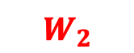
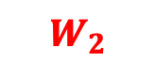



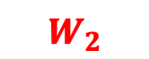
Distributed Key-value Stores
Asynchrony Data updates may not arrive at all servers simultaneously.
$$−$$
$$−$$
$$−$$
$$W_{1}$$
$$W_{1}$$
$$−$$
$$W_{2}$$
$$−$$
$$W_{2}$$
$$W_{2}$$
$$W_{2}$$
$$−$$

Slide 11
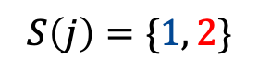
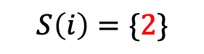




Distributed Key-value Stores
Asynchrony Data updates may not arrive at all servers simultaneously.
Decentralized Nature
A server may not be aware of which updates received by others.
$$i$$
$$j$$
$$−$$
$$W_{1}$$
$$W_{2}$$
$$W_{2}$$
$$S\left(i\right)=\{2\}$$
$$S\left(j\right)=\{1, 2\}$$

Slide 12


Distributed Key-value Stores
Asynchrony Data updates may not arrive at all servers simultaneously.
Decentralized Nature
A server may not be aware of which updates received by others.
$$i$$
$$j$$
does not know $$S(j)$$
does not know $$S(i)$$
$$−$$
$$W_{1}$$
$$W_{2}$$
$$W_{2}$$
$$S\left(i\right)=\{2\}$$
$$S\left(j\right)=\{1, 2\}$$

Slide 13






Distributed Key-value Stores
Asynchrony Data updates may not arrive at all servers simultaneously.
Decentralized Nature
A server may not be aware of which updates received by others.
3. Consistency
A client must retrieve the latest possible update.
$${value: W}_{1}$$
$${value: W}_{2}$$
Read client: reads $W_{2}$
$$W_{1}$$
$$W_{2}$$
$$W_{2}$$

Slide 14
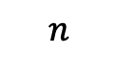
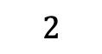
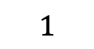
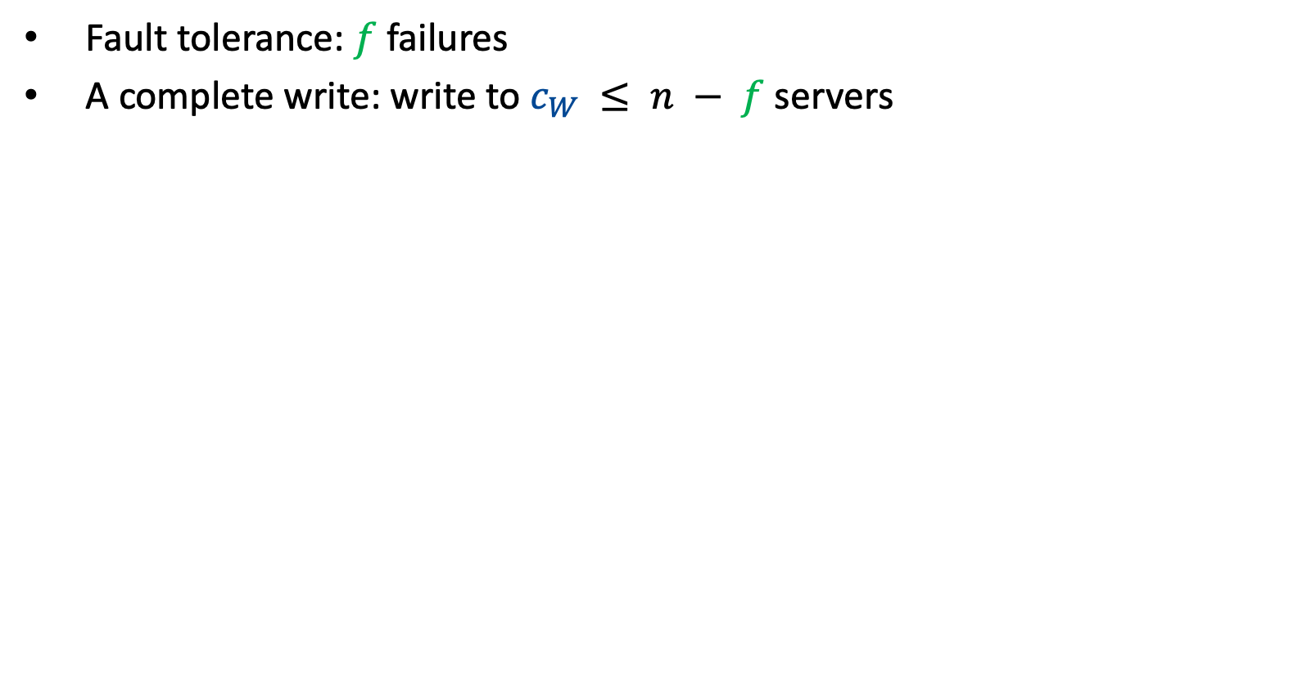
How to handle asynchrony & failures?
Fault tolerance: $f$ failures
A complete write: write to $c_{W} ≤ n − f$ servers
Write request
Write client
$$1$$
$$2$$
$$n$$

Slide 15

How to handle asynchrony & failures?
Fault tolerance: $f$ failures
A complete write: write to $c_{W} ≤ n − f$ servers
ACK
Write client
$$n$$
$$1$$
$$2$$
$$f=1$$

Slide 16
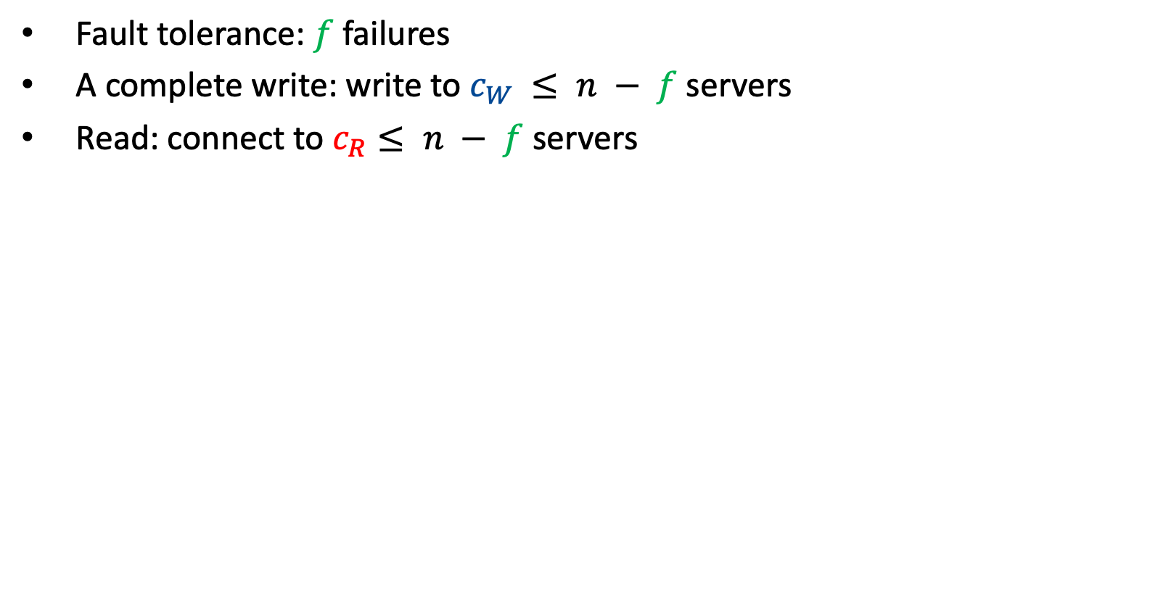
How to handle asynchrony & failures?
Fault tolerance: $f$ failures
A complete write: write to $c_{W} ≤ n − f$ servers
Read: connect to $c_{R}≤ n − f$ servers
ACK
Write client
$$n$$
$$1$$
$$2$$
$$f=1$$
Read client
Read Request

Slide 17
How to handle asynchrony & failures?
Fault tolerance: $f$ failures
A complete write: write to $c_{W} ≤ n − f$ servers
Read: connect to $c_{R}≤ n − f$ servers
ACK
Write client
$$n$$
$$1$$
$$2$$
$$f=1$$
Read client
ACK

Slide 18
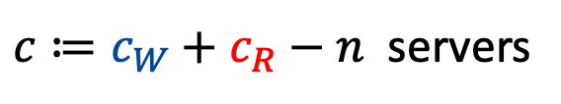
How to handle asynchrony & failures?
Fault tolerance: $f$ failures
A complete write: write to $c_{W} ≤ n − f$ servers
Read: connect to $c_{R}≤ n − f$ servers
Write client
$c≔c_{W}+c_{R}−n$ servers
$$n$$
$$1$$
$$2$$
$$f=1$$
Read client

Slide 19
How to handle asynchrony & failures?
Strong Consistency: decode the latest complete version (or a later incomplete version)
Write client
$c≔c_{W}+c_{R}−n$ servers
$$n$$
$$1$$
$$2$$
$$f=1$$
Read client

Slide 20

How to handle asynchrony & failures?
Strong Consistency: decode the latest complete version (or a later incomplete version)
Write client
$c≔c_{W}+c_{R}−n$ servers
$$n$$
$$1$$
$$2$$
$$f=1$$
Read client
Replication: $c_{W}+c_{R}>n$

Slide 21



Background: Replication
Replication
$$K$$
Version
no of bits
$$K$$
$$W_{1}$$
Write client

Slide 22
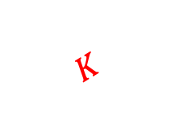

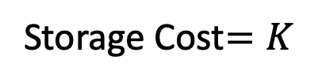

Background: Replication
Replication
Storage Cost$=K$
node stores only latest version
$$K$$
Version
no of bits
$$K$$
$$W_{1}$$
$$K$$
$$W_{2}$$
Write client

Slide 23
Background: Replication
Replication
Storage Cost$=K$
node stores only latest version
$$K$$
Version
no of bits
$$K$$
$$W_{1}$$
$$K$$
$$W_{2}$$
Write client
Significant Communication and Storage Costs

Slide 24

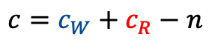
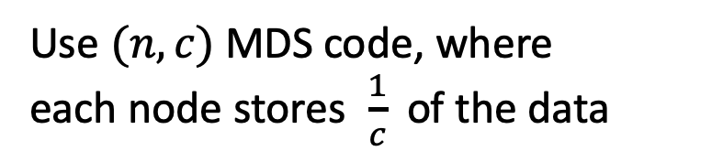

Background: Replication
Replication
Storage Cost$=K$
node stores only latest version
$$K$$
Version
no of bits
$$K$$
$$W_{1}$$
$$K$$
$$W_{2}$$
Write client
Significant Communication and Storage Costs
$$c_{W}$$
Use $(n, c)$ MDS code, where
each node stores $\frac{1}{c}$ of the data
$$c_{R}$$
$$c=c_{W}+c_{R}−n$$

Slide 25

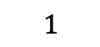

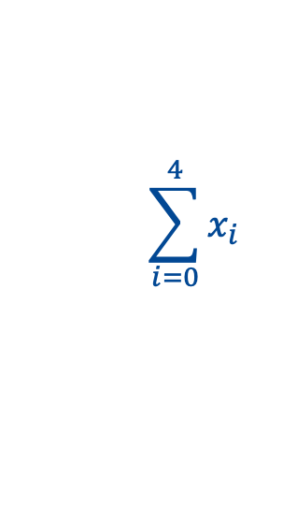


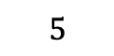
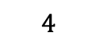

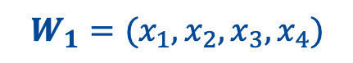

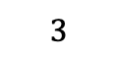
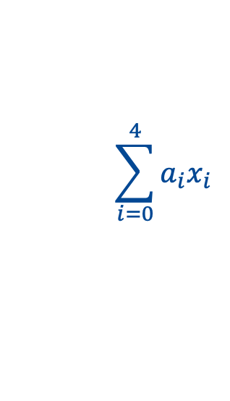
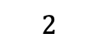
Background: Erasure Coding Challenges
Write client
$$(6, 4)$$
MDS code
$$2$$
$$3$$
$$4$$
$$5$$
$$6$$
$$1$$
$$W_{1}=(x_{1},x_{2}, x_{3}, x_{4})$$
$$\sum_{i=0}^{4}{x_{i}}$$
$$\sum_{i=0}^{4}{{a_{i}x}_{i}}$$
$$x_{1}$$
$$x_{2}$$
$$x_{3}$$
$$x_{4}$$

Slide 26


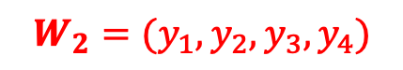



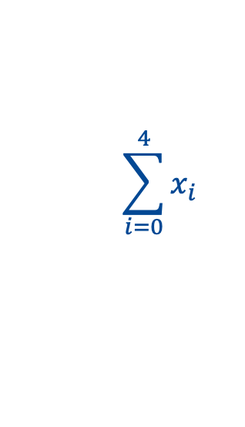

Background: Erasure Coding Challenges
Write client
$$(6, 4)$$
MDS code
$$2$$
$$3$$
$$4$$
$$5$$
$$6$$
$$1$$
$$W_{1}=(x_{1},x_{2}, x_{3}, x_{4})$$
$$\sum_{i=0}^{4}{x_{i}}$$
$$\sum_{i=0}^{4}{{a_{i}x}_{i}}$$
$$x_{1}$$
$$x_{2}$$
$$x_{3}$$
$$x_{4}$$
Write client
$$\sum_{i=0}^{4}{x_{i}}$$
$$\sum_{i=0}^{4}{{a_{i}x}_{i}}$$
$$(6, 4)$$
MDS code
$$y_{2}$$
$$y_{3}$$
$$x_{4}$$
$$y_{1}$$
$$W_{2}=(y_{1},y_{2}, y_{3}, y_{4})$$
did not get the new version

Slide 27


Background: Erasure Coding Challenges
Write client
$$(6, 4)$$
MDS code
$$2$$
$$3$$
$$4$$
$$5$$
$$6$$
$$1$$
$$W_{1}=(x_{1},x_{2}, x_{3}, x_{4})$$
$$\sum_{i=0}^{4}{x_{i}}$$
$$\sum_{i=0}^{4}{{a_{i}x}_{i}}$$
$$x_{1}$$
$$x_{2}$$
$$x_{3}$$
$$x_{4}$$
Write client
$$\sum_{i=0}^{4}{x_{i}}$$
$$\sum_{i=0}^{4}{{a_{i}x}_{i}}$$
$$(6, 4)$$
MDS code
$$y_{2}$$
$$y_{3}$$
$$x_{4}$$
$$y_{1}$$
$$W_{2}=(y_{1},y_{2}, y_{3}, y_{4})$$
cannot decode
did not get the new version
$W_{1}$ nor $W_{2}$
Read client
needs $4$ symbols of the same version

Slide 28

Background: Erasure Coding Challenges
Write client
$$(6, 4)$$
MDS code
$$2$$
$$3$$
$$4$$
$$5$$
$$6$$
$$1$$
$$W_{1}=(x_{1},x_{2}, x_{3}, x_{4})$$
$$\sum_{i=0}^{4}{x_{i}}$$
$$\sum_{i=0}^{4}{{a_{i}x}_{i}}$$
$$x_{1}$$
$$x_{2}$$
$$x_{3}$$
$$x_{4}$$
Write client
$$\sum_{i=0}^{4}{x_{i}}$$
$$\sum_{i=0}^{4}{{a_{i}x}_{i}}$$
$$(6, 4)$$
MDS code
$$y_{2}$$
$$y_{3}$$
$$x_{4}$$
$$y_{1}$$
$$W_{2}=(y_{1},y_{2}, y_{3}, y_{4})$$
$$W_{1}$$
can decode
nodes have to store
multiple versions
Read client

Slide 29



Background: Erasure Coding Challenges
Replication
Storage Cost$=K$
$$K$$
Version
no of bits
$$K$$
$$W_{1}$$
$$K$$
$$W_{2}$$
Write client
Simple Erasure
Coding
Version
no of bits
$$K/c$$
$$W_{1}$$
$$K/c$$
Write client

Slide 30



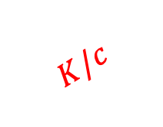
Background: Erasure Coding Challenges
Replication
Storage Cost$=K$
$$K$$
Version
no of bits
$$K$$
$$W_{1}$$
$$K$$
$$W_{2}$$
Write client
Simple Erasure
Coding
Storage Cost$=ν \frac{1}{c} K$
Version
no of bits
$$K/c$$
$$W_{1}$$
$$K/c$$
$$W_{2}$$
$$K/c$$
Write client

Slide 31

Background: Erasure Coding Challenges
Replication
Storage Cost$=K$
node stores only latest version
Version
no of bits
$$K$$
$$W_{1}$$
$$K$$
$$W_{2}$$
Simple Erasure
Coding
Storage Cost$=ν \frac{1}{c} K$
node stores multiple versions
Version
no of bits
$$W_{1}$$
$$K/c$$
$$W_{2}$$
$$K/c$$

Slide 32
Background: Erasure Coding Challenges
Replication
Storage Cost$=K$
Version
no of bits
$$K$$
$$W_{1}$$
$$K$$
Erasure coding gain
$$W_{2}$$
Simple Erasure
Coding
Storage Cost$=ν \frac{1}{c} K$
Version
no of bits
$$W_{1}$$
$$K/c$$
$$W_{2}$$
$$K/c$$

Slide 33
Background: Erasure Coding Challenges
Replication
Storage Cost$=K$
Version
no of bits
$$K$$
$$W_{1}$$
$$K$$
Erasure coding gain
$$W_{2}$$
Simple Erasure
Coding
Storage Cost$=ν \frac{1}{c} K$
Version
no of bits
Offsets the gain
$$W_{1}$$
$$K/c$$
$$W_{2}$$
$$K/c$$

Slide 34
Background: Erasure Coding Challenges
Replication
Storage Cost$=K$
Version
no of bits
$$K$$
$$W_{1}$$
$$K$$
Erasure coding gain
$$W_{2}$$
Simple Erasure
Coding
Storage Cost$=ν \frac{1}{c} K$
Version
no of bits
Offsets the gain
$$W_{1}$$
$$K/c$$
Can we do better?
$$W_{2}$$
$$K/c$$

Slide 35

Background: Erasure Coding Challenges
Replication
Storage Cost$=K$
Version
no of bits
$$K$$
$$W_{1}$$
$$K$$
Erasure coding gain
$$W_{2}$$
Simple Erasure
Coding
Storage Cost$=ν \frac{1}{c} K$
Version
no of bits
Offsets the gain
$$W_{1}$$
$$K/c$$
Can we do better?
$$W_{2}$$
$$K/c$$
Storage Cost$≥\frac{ν}{2} \frac{1}{c} K−Θ(1), ν<c$
[Wang et al. 2014]

Slide 36

Erasure-coded Key-value Stores
with Side Information
Decentralized
[Wang et al. 2014]
$$Storage Cost≥\left(\frac{ν}{c}−\frac{ν\left(ν−1 \right)}{c^{2}}+o\left(\frac{1}{c^{2}}\right)\right)K$$

Slide 37
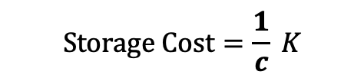
Erasure-coded Key-value Stores
with Side Information
Decentralized
[Wang et al. 2014]
Centralized
$$Storage Cost≥\left(\frac{ν}{c}−\frac{ν\left(ν−1 \right)}{c^{2}}+o\left(\frac{1}{c^{2}}\right)\right)K$$
$$Storage Cost=\frac{1}{c} K$$

Slide 38
Erasure-coded Key-value Stores
with Side Information
Decentralized
[Wang et al. 2014]
Centralized
$$Storage Cost≥\left(\frac{ν}{c}−\frac{ν\left(ν−1 \right)}{c^{2}}+o\left(\frac{1}{c^{2}}\right)\right)K$$
$$Storage Cost=\frac{1}{c} K$$
High Latency
Geo-distributed
key-value store

Slide 39

Erasure-coded Key-value Stores
with Side Information
Decentralized
[Wang et al. 2014]
Centralized
$$Storage Cost≥\left(\frac{ν}{c}−\frac{ν\left(ν−1 \right)}{c^{2}}+o\left(\frac{1}{c^{2}}\right)\right)K$$
$$Storage Cost=\frac{1}{c} K$$
$$Storage Cost?$$
High Latency
This Work: Coding with Partial Side Information
Geo-distributed
key-value store
Latency-Storage Trade-off

Slide 40


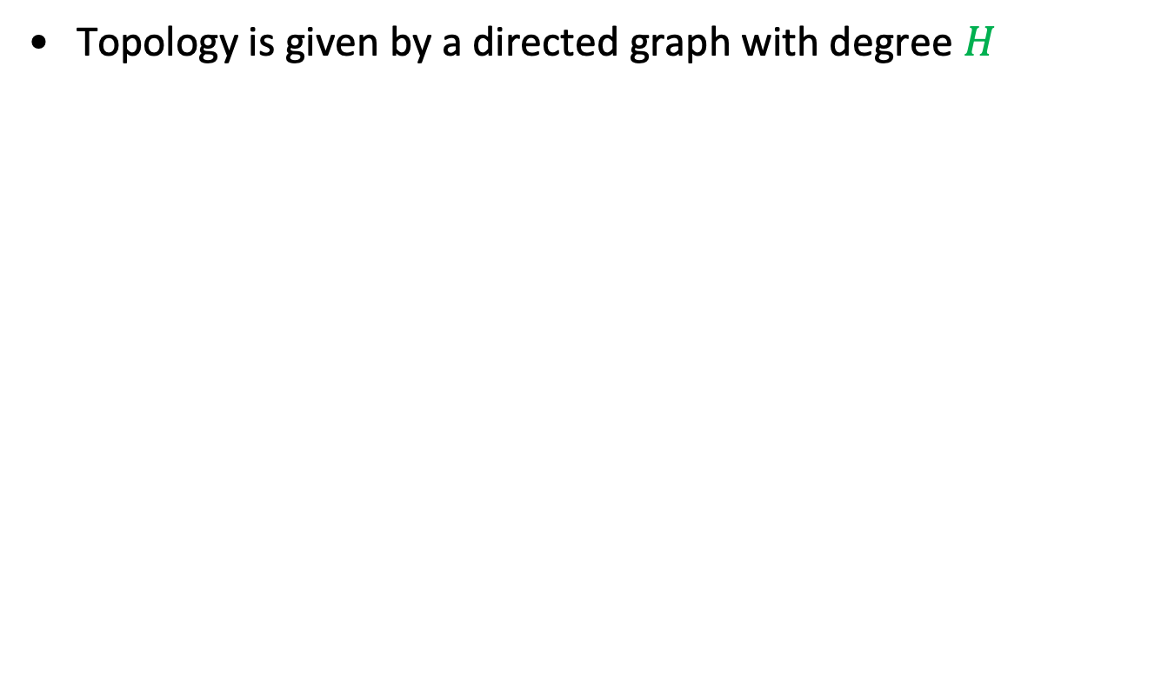




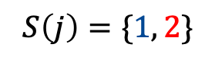




Coding with Side Information
Topology is given by a directed graph with degree $H$
$$𝒢=(𝒩, ℰ)$$
$$i$$
$$j$$
knows $S(j)$
knows $S(i)$
$$−$$
$$W_{1}$$
$$W_{2}$$
$$W_{2}$$
$$S\left(i\right)=\{2\}$$
$$S\left(j\right)=\{1, 2\}$$

Slide 41
Coding with Side Information
Topology is given by a directed graph with degree $H$
$$𝒢=(𝒩, ℰ)$$
$$i$$
$$j$$
knows $S(j)$
knows $S(i)$
$$−$$
$$W_{1}$$
$$W_{2}$$
$$W_{2}$$
$$S\left(i\right)=\{2\}$$
$$S\left(j\right)=\{1, 2\}$$
Decoding Requirement: latest complete version (or a later version)

Slide 42
Coding with Side Information
Topology is given by a directed graph with degree $H$
$$𝒢=(𝒩, ℰ)$$
$$i$$
$$j$$
knows $S(j)$
knows $S(i)$
$$−$$
$$W_{1}$$
$$W_{2}$$
$$W_{2}$$
$$S\left(i\right)=\{2\}$$
$$S\left(j\right)=\{1, 2\}$$
Decoding Requirement: latest complete version (or a later version)
Idea: Can the servers guess which version is the latest complete?

Slide 43
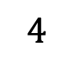
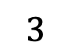
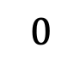
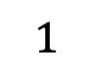

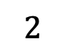
Coding with Side Information: Challenges
Can the servers guess which version is the latest complete?
$$0$$
$$4$$
$$1$$
$$3$$
$$2$$
$$c_{W}=4$$

Slide 44
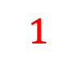



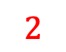
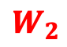
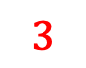
Coding with Side Information: Challenges
Can the servers guess which version is the latest complete?
$$0$$
$$4$$
$$1$$
$$W_{2}$$
$$3$$
$$2$$
$$W_{2}$$
$$W_{2}$$
$$c_{W}=4$$
$W_{2}$ is incomplete

Slide 45
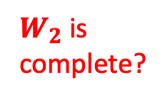
Coding with Side Information: Challenges
Can the servers guess which version is the latest complete?
$$0$$
$W_{2}$ is
complete?
$$4$$
$$1$$
$$W_{2}$$
$$3$$
$$2$$
$$W_{2}$$
$$W_{2}$$
$$c_{W}=4$$
$W_{2}$ is incomplete

Slide 46
Coding with Side Information: Challenges
Can the servers guess which version is the latest complete?
$$0$$
$W_{2}$ is
complete?
No
$$4$$
$$1$$
$$W_{2}$$
$$3$$
$$2$$
$$W_{2}$$
$$W_{2}$$
$$c_{W}=4$$
$W_{2}$ is incomplete

Slide 47

Coding with Side Information: Challenges
Can the servers guess which version is the latest complete?
$$0$$
$$4$$
$$1$$
$$W_{2}$$
$$3$$
$$2$$
$W_{2}$ is
complete?
$$W_{2}$$
$$W_{2}$$
$$c_{W}=4$$
$W_{2}$ is incomplete

Slide 48


Coding with Side Information: Challenges
Can the servers guess which version is the latest complete?
$$0$$
$$4$$
$$1$$
$$W_{2}$$
Yes, if node $0$ has it
$$3$$
$$2$$
$W_{2}$ is
complete?
$$W_{2}$$
$$W_{2}$$
$$c_{W}=4$$
No, if node $0$ does not have it
$W_{2}$ is incomplete

Slide 49
Coding with Side Information: Challenges
Can the servers guess which version is the latest complete?
$$0$$
$$4$$
$$1$$
$$W_{2}$$
Yes, if node $0$ has it
$$3$$
$$2$$
$W_{2}$ is
complete?
$$W_{2}$$
$$W_{2}$$
$$c_{W}=4$$
No, if node $0$ does not have it
node $2$ does not know that $W_{2}$is incomplete!

Slide 50
Coding with Side Information: Challenges
Can the servers guess which version is the latest complete?
$$0$$
$$4$$
$$1$$
$$W_{2}$$
Yes, if node $0$ has it
$$3$$
$$2$$
$W_{2}$ is
complete?
$$W_{2}$$
$$W_{2}$$
$$c_{W}=4$$
No, if node $0$ does not have it
node $2$ does not know that $W_{2}$is incomplete!
Given $𝒢$, how many servers cannot guess correctly?

Slide 51


Coding with Side Information: Challenges
Server Side Information
Complete Version
$H$ servers
$c_{W}$ servers having $W_{2}$
observes at least $c_{W}+H−n$ servers having $W_{2}$

Slide 52
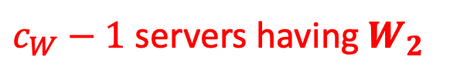

Coding with Side Information: Challenges
Server Side Information
Complete Version
$H$ servers
$c_{W}$ servers having $W_{2}$
observes at least $c_{W}+H−n$ servers having $W_{2}$
Server Side Information
Incomplete Version
$H$ servers
$c_{W}−1$ servers having $W_{2}$
may still observe at least $c_{W}+H−n$ servers having $W_{2}$

Slide 53
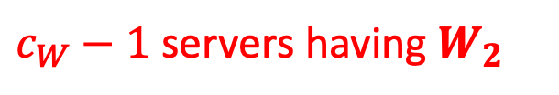
Coding with Side Information: Challenges
Server Side Information
Incomplete Version
$H$ servers
$c_{W}−1$ servers having $W_{2}$
may still at least $c_{W}+H−n$ servers having $W_{2}$
Given an incomplete version, how many servers may assume it is complete?

Slide 54
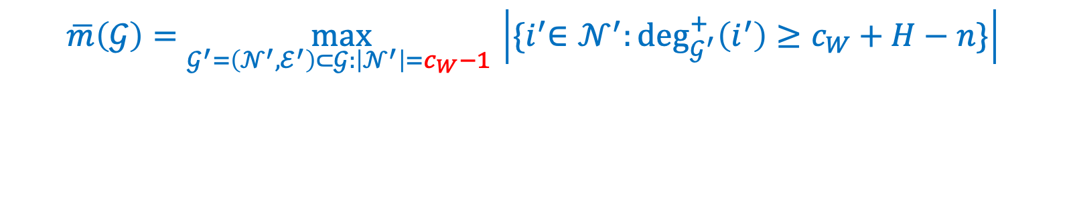
Coding with Side Information: Challenges
Server Side Information
Incomplete Version
$H$ servers
$c_{W}−1$ servers having $W_{2}$
may still at least $c_{W}+H−n$ servers having $W_{2}$
Given an incomplete version, how many servers may assume it is complete?
$$\overline{m}\left(𝒢\right)=\max_{𝒢^{′}=\left(𝒩^{′}, ℰ^{′}\right)⊂𝒢:\left|𝒩^{′}\right|=c_{W}−1 }\left|{\{i}^{′}∈𝒩^{′}:\deg_{𝒢^{′}}^{+}\left(i^{′}\right)≥c_{W}+H−n\}\right|$$

Slide 55
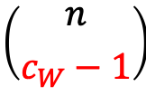
Coding with Side Information: Challenges
Server Side Information
Incomplete Version
$H$ servers
$c_{W}−1$ servers having $W_{2}$
may still at least $c_{W}+H−n$ servers having $W_{2}$
Given an incomplete version, how many servers may assume it is complete?
$$\overline{m}\left(𝒢\right)=\max_{𝒢^{′}=\left(𝒩^{′}, ℰ^{′}\right)⊂𝒢:\left|𝒩^{′}\right|=c_{W}−1 }\left|{\{i}^{′}∈𝒩^{′}:\deg_{𝒢^{′}}^{+}\left(i^{′}\right)≥c_{W}+H−n\}\right|$$
We need to consider
$$\left({n \atop c_{W}−1}\right)$$
graphs
Computationally challenging for large graphs

Slide 56

Coding with Side Information: Challenges
Server Side Information
Incomplete Version
$H$ servers
$c_{W}−1$ servers having $W_{2}$
may still at least $c_{W}+H−n$ servers having $W_{2}$
Given an incomplete version, how many servers may assume it is complete?
$$\overline{m}\left(𝒢\right)=\max_{𝒢^{′}=\left(𝒩^{′}, ℰ^{′}\right)⊂𝒢:\left|𝒩^{′}\right|=c_{W}−1 }\left|{\{i}^{′}∈𝒩^{′}:\deg_{𝒢^{′}}^{+}\left(i^{′}\right)≥c_{W}+H−n\}\right|$$
We need to consider
$$\left({n \atop c_{W}−1}\right)$$
graphs
Computationally challenging for large graphs
$$\overline{m}\left(𝒢\right)≤\left(n−c_{W}+1\right) (n−H)$$

Slide 57
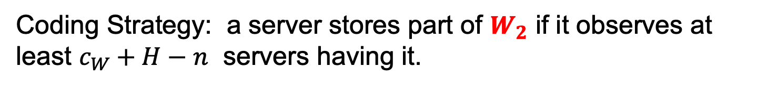
Coding with Side Information: Construction
Server Side Information
Incomplete Version
$H$ servers
$c_{W}−1$ servers having $W_{2}$
may still at least $c_{W}+H−n$ servers having $W_{2}$
Coding Strategy: a server stores part of $W_{2}$ if it observes at least $c_{W}+H−n$ servers having it.

Slide 58
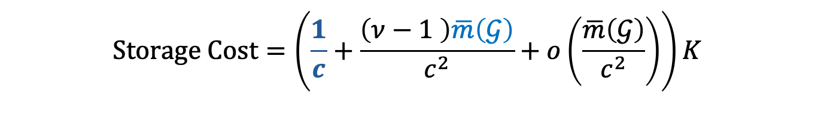

Coding with Side Information: Construction
Server Side Information
Incomplete Version
$H$ servers
$c_{W}−1$ servers having $W_{2}$
may still at least $c_{W}+H−n$ servers having $W_{2}$
Coding Strategy: a server stores part of $W_{2}$ if it observes at least $c_{W}+H−n$ servers having it.
At most $\overline{m}\left(𝒢\right)$ servers store $W_{2}$ when it is incomplete.
$$Storage Cost=\left(\frac{1}{c}+\frac{\left(ν−1 \right)\overline{m}\left(𝒢\right)}{c^{2}}+o\left(\frac{\overline{m}\left(𝒢\right)}{c^{2}}\right)\right)K$$

Slide 59
Coding with Side Information
Decentralized
Partial Information
Centralized
$$Storage Cost≥\left(\frac{ν}{c}−\frac{ν\left(ν−1 \right)}{c^{2}}+o\left(\frac{1}{c^{2}}\right)\right)K$$
$$Storage Cost=\frac{1}{c} K$$
$$Storage Cost=\left(\frac{1}{c}+\frac{\left(ν−1 \right)\overline{m}\left(𝒢\right)}{c^{2}}+o\left(\frac{\overline{m}\left(𝒢\right)}{c^{2}}\right)\right)K$$

Slide 60


Coding with Side Information
Decentralized
Partial Information
Centralized
$$Storage Cost≥\left(\frac{ν}{c}−\frac{ν\left(ν−1 \right)}{c^{2}}+o\left(\frac{1}{c^{2}}\right)\right)K$$
$$Storage Cost=\frac{1}{c} K$$
Storage Reduction $=11\%$
$$(n=5, c_{W}=c_{R}=4, ν=2)$$

Slide 61
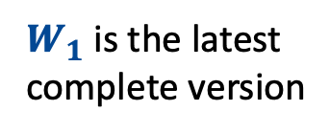

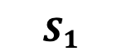

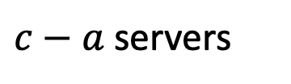

Impossibility Results
$$S_{1}$$
$W_{1}$ is the latest complete version
$a$servers
$c−a$servers
$$W_{1}$$
$W_{1}$ and $W_{2}$

Slide 62

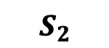
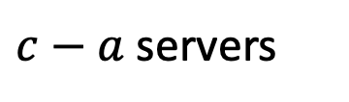




Impossibility Results
$$S_{1}$$
$W_{1}$ is the latest complete version
$a$servers
$c−a$servers
$$W_{1}$$
$W_{1}$ and $W_{2}$
$$S_{2}$$
$W_{2}$ is the latest complete version
$a$servers
$c−a$servers
$W_{1}$ and $W_{2}$
$W_{1}$ and $W_{2}$
cannot differentiate between $S_{1}$ and $S_{2}$

Slide 63


Impossibility Results
$$S_{1}$$
$W_{1}$ is the latest complete version
$a$servers
$c−a$servers
$$W_{1}$$
$W_{1}$ and $W_{2}$
$$S_{2}$$
$W_{2}$ is the latest complete version
$a$servers
$c−a$servers
$W_{1}$ and $W_{2}$
$W_{1}$ and $W_{2}$
$$Storage Cost≥{\frac{1}{c−a}K }$$
Decoding $W_{2}$ in $S_{1}$

Slide 64




Impossibility Results
$$S_{1}$$
$W_{1}$ is the latest complete version
$a$servers
$c−a$servers
$$W_{1}$$
$W_{1}$ and $W_{2}$
$$S_{2}$$
$W_{2}$ is the latest complete version
$a$servers
$c−a$servers
$W_{1}$ and $W_{2}$
$W_{1}$ and $W_{2}$
$W_{1}$ in $S_{1}$
$$Storage Cost≥{\frac{2}{c+a}K }$$
$W_{2}$ in $S_{2}$
Decoding $W_{1}$ in $S_{1}$
$$c servers of S_{1} and the a servers of S_{2}$$

Slide 65

Impossibility Results
$$S_{1}$$
$W_{1}$ is the latest complete version
$a$servers
$c−a$servers
$$W_{1}$$
$W_{1}$ and $W_{2}$
$$S_{2}$$
$W_{2}$ is the latest complete version
$a$servers
$c−a$servers
$W_{1}$ and $W_{2}$
$W_{1}$ and $W_{2}$
$$Storage Cost≥min\left\{\frac{1}{c−a},\frac{2}{c+a}\right\}K$$

Slide 66




Impossibility Results
$$Storage Cost≥min\left\{\frac{1}{c−a},\frac{2}{c+a}\right\}K$$
Implication:
Side Information is not useful
$$(n=5, c_{W}=c_{R}=4, ν=2)$$
$$(c=3, a=1)$$
$$Storage Cost ≥K/2$$
Can be achieved without side information [Wang et al. 2014]

Slide 67

Coding with Side Information
Decentralized
Partial Information
Centralized
Side Information
is not useful
Side Information
is useful
$$(n=5, c_{W}=c_{R}=4, ν=2)$$
A careful study of the network topology is necessary

Slide 68


Case Study: Amazon Web Services (AWS)

Slide 69


Case Study: AWS Inter-Region Latency
Source: https://www.cloudping.co/
An edge exists between node $i$ and node $j$ if the latency between them
$≤$ maximum allowable latency

Slide 70

Case Study: Latency-Storage Trade-off in AWS
Storage Cost without Side information
Storage Cost with Side information
$$ms$$
Decentralized
Partial Information
Centralized

Slide 71

Discussion
Decentralized
Partial Information
Centralized
Side Information
is not useful
Side Information
is useful
$$(n=5, c_{W}=c_{R}=4, ν=2)$$

Slide 72
Questions? Thank You

